Slide 1
Keeping the lights on at DoneDeal
Notes:
Summer school 2013, Started Work placement Jan 2014
DoneDeal started 2005. 12th year.

Slide 2
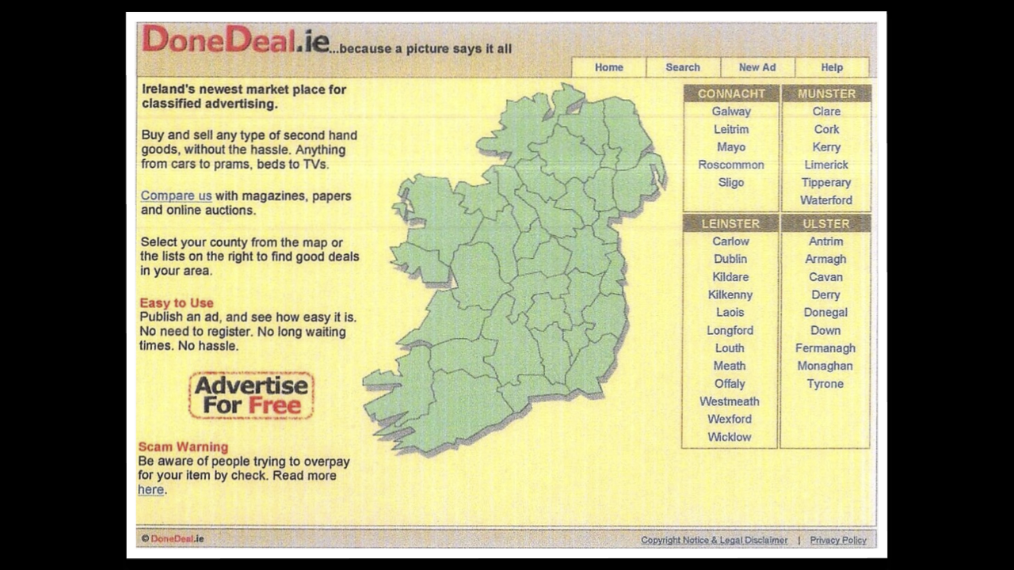
The first iteration!
Notes:
Wexford-based DoneDeal is Ireland’s biggest and most successful classifieds website and today claims a market leadership position four times as big as its nearest competitor. From a standing start in 2005, the website has experienced an average of 10-15% growth in visitor traffic and ad placements per month. By 2014, company turnover reached over €8 million and active ads totalled more than 230,000. DoneDeal is now the number one place to buy and sell things in Ireland, according to Google Trends.
A screenshot of the home page when we launched. There were no designers. So it was designed by a techie. Shows that techies should not be allowed to do design!
Mother-in-law-test: our philosophy to make sure the site was easy to use

Slide 3
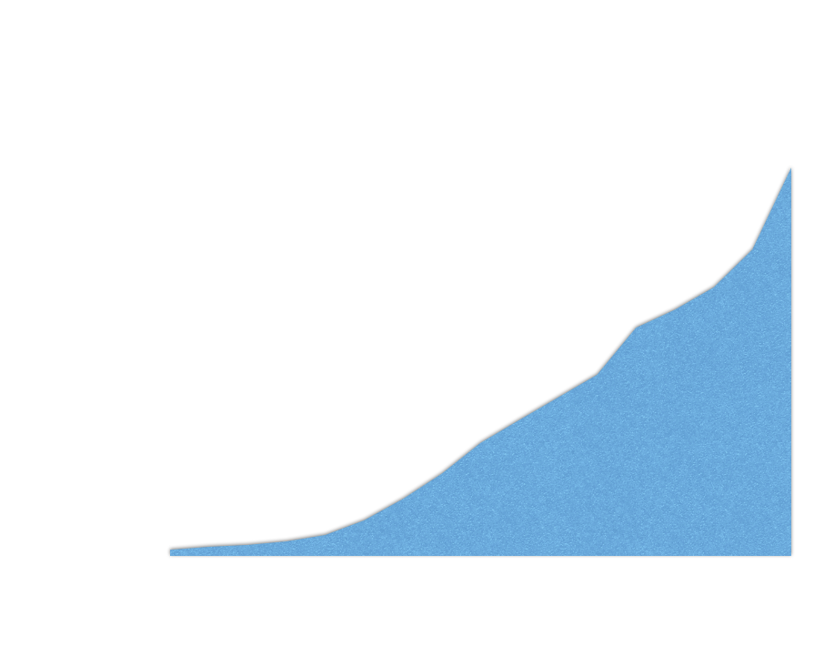
Notes:
Since the website launched, DoneDeal has grown consistently by 10% month on month. In 2016, we had 5.1B Page Views, 347M Visits.

Slide 4
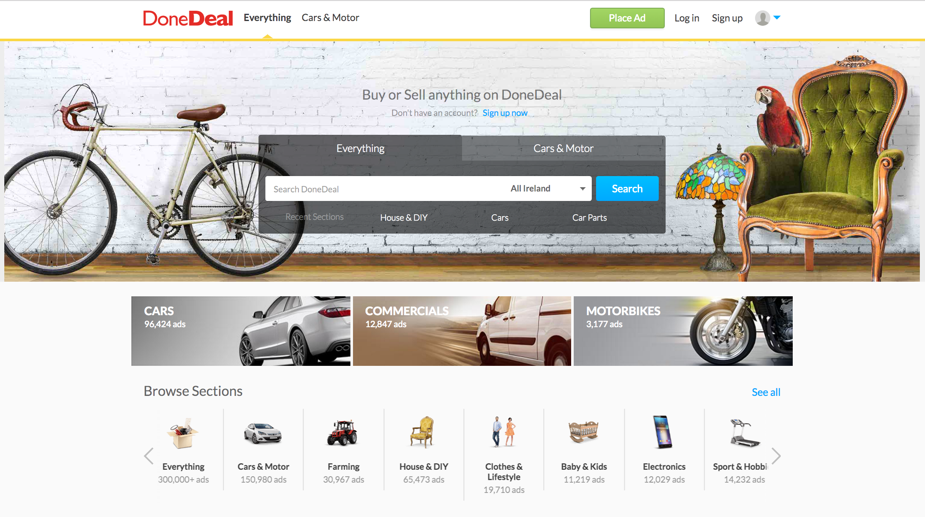
Today :)

Slide 5



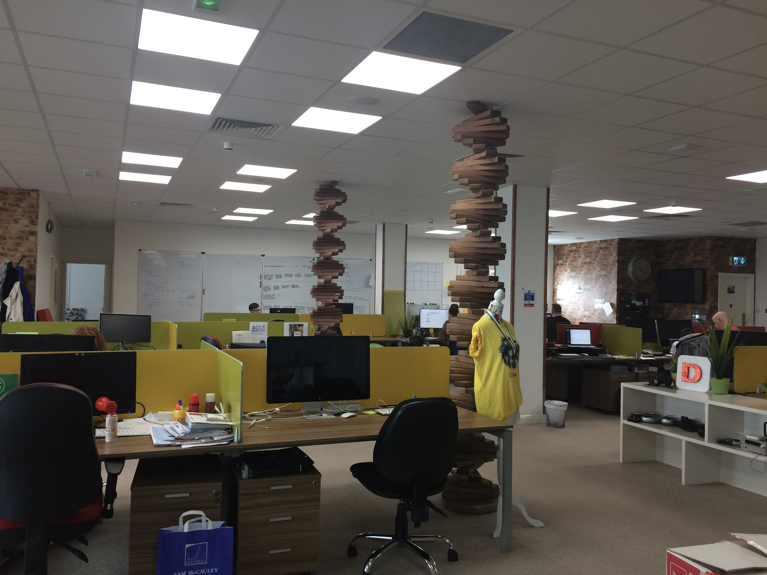
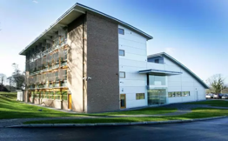
Notes:
DoneDeal was bought by Schibsted Media Group - an Oslo-listed international media group and leading player within online marketplaces globally.
In July 2015 the Irish-owned Distilled Media Group and Schibsted joined forces to create Distilled SCH.
DistilledSCH covers DoneDeal, Daft and Adverts.
The DoneDeal platform is developed in the South East.
Our main office is in Wexford and we have small office in ArcLabs
20 on the Engineering Team and we have 5 posts to fill (2 QA interns, Android Dev and 2 Java)
We’ve recently moved all teams to Kanban/Lean. It’s early days but we’re spending a lot of time looking at how we can improve how we work and how our teams interact with each other.
Scaling the team….To keep the lights on.

Slide 6





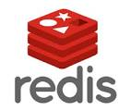




Key Technologies
Notes:
Spring for Rest APIs with a JSON payload enables us to reach all of our clients easily
ES introduced in 2013 version 1.0.1 developed against 0.9x - ES company formed just as we launched
Redis was a huge success for session management / caching
Running approx 1 year on Openshift in production for container orchestration *its awesome*
Docker has really helped with consistency between environments and brought developers closer to production systems

Slide 7
Delivering features faster
All code deployed using docker containers
Moved from 5:30am deploy to continuous delivery using RedHat Openshift
Very easy to rollback failed deploys
Really easy to start QA environments from git branches to test features quickly
We always automate where possible
Notes:
2016 CD Project
Legacy 5:30 am releases = SLOW
Move to containers instead of fixed VMs
Release anytime
Easy rollbacks = Move fast break often
Dynamic QA envs
Automate Automate Automate
Always changing, refactoring, killing legacy

Slide 8
Some interesting stats

Slide 9
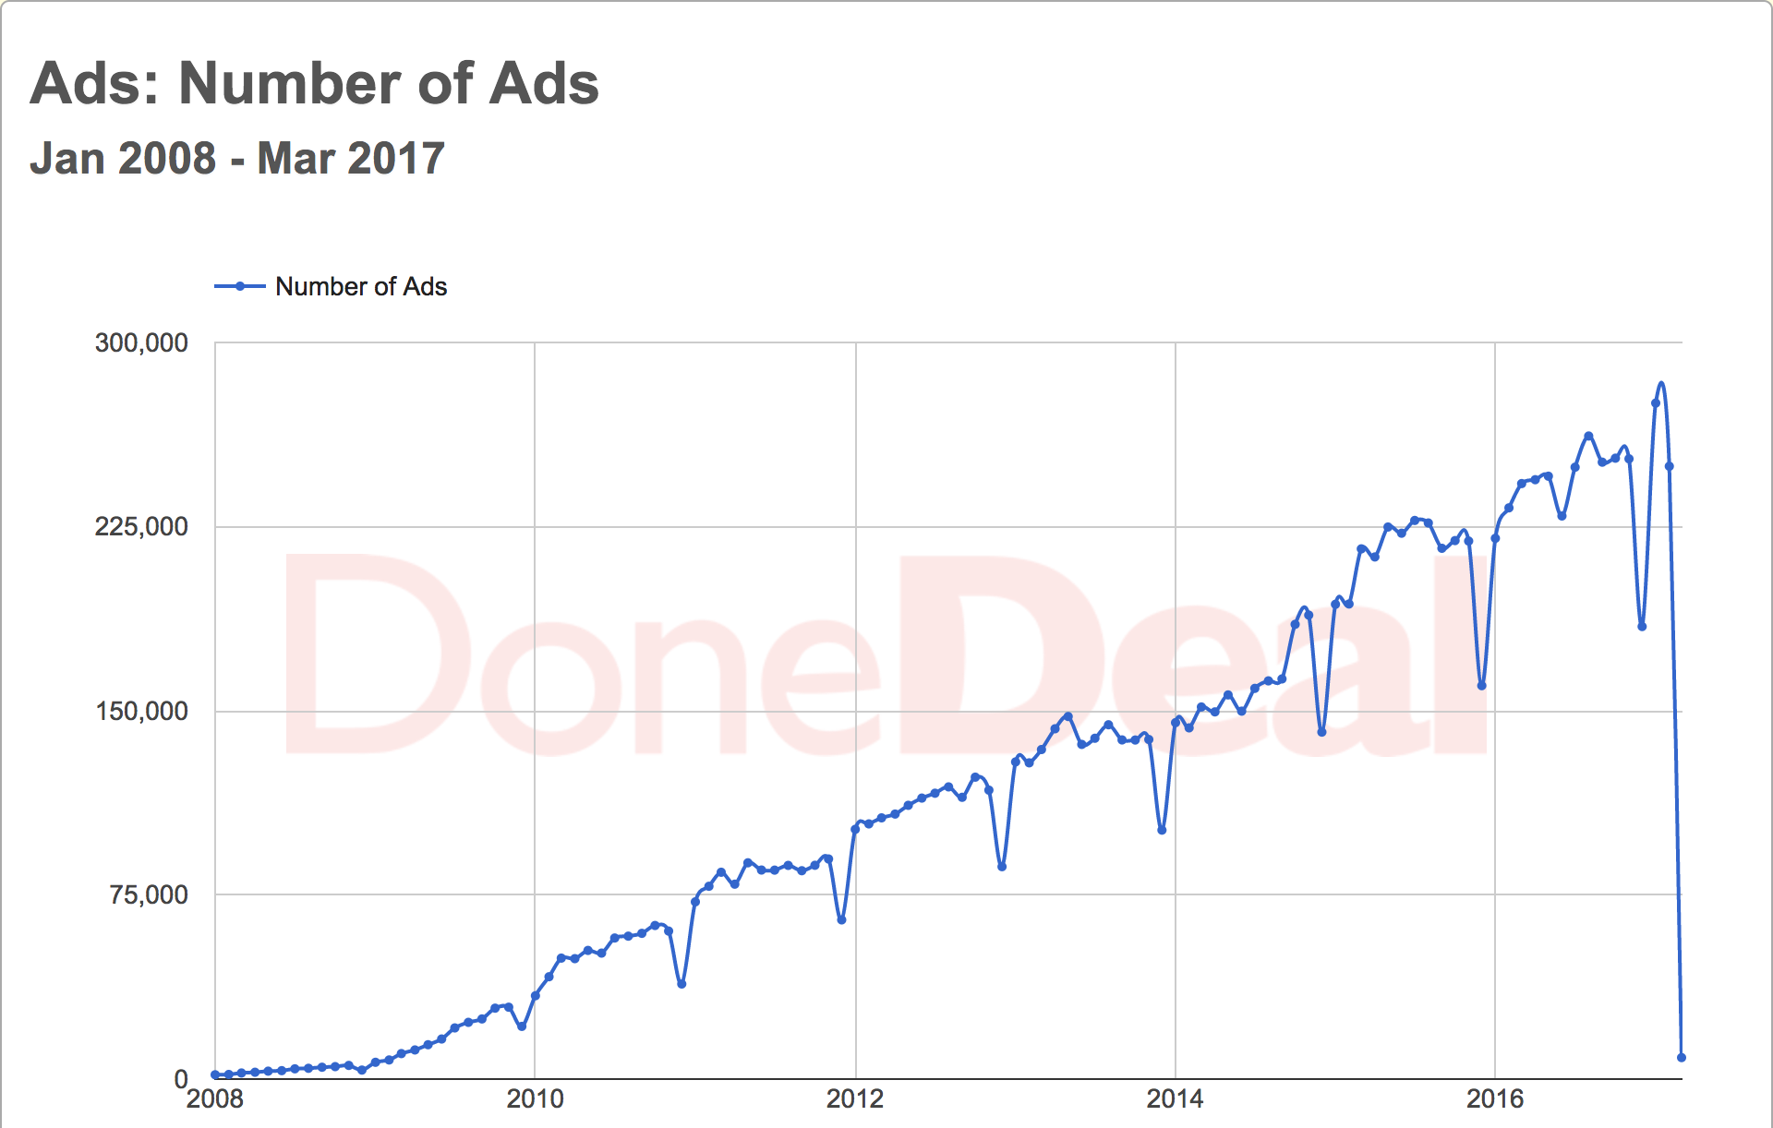
Notes:
In 2008, the website carried a total of 6,000 ads. Today, we have in total ~330K ads and get ~10,000 new ads per day.
Interesting to see dip every Christmas and when we got our 1 week summer every year.

Slide 10
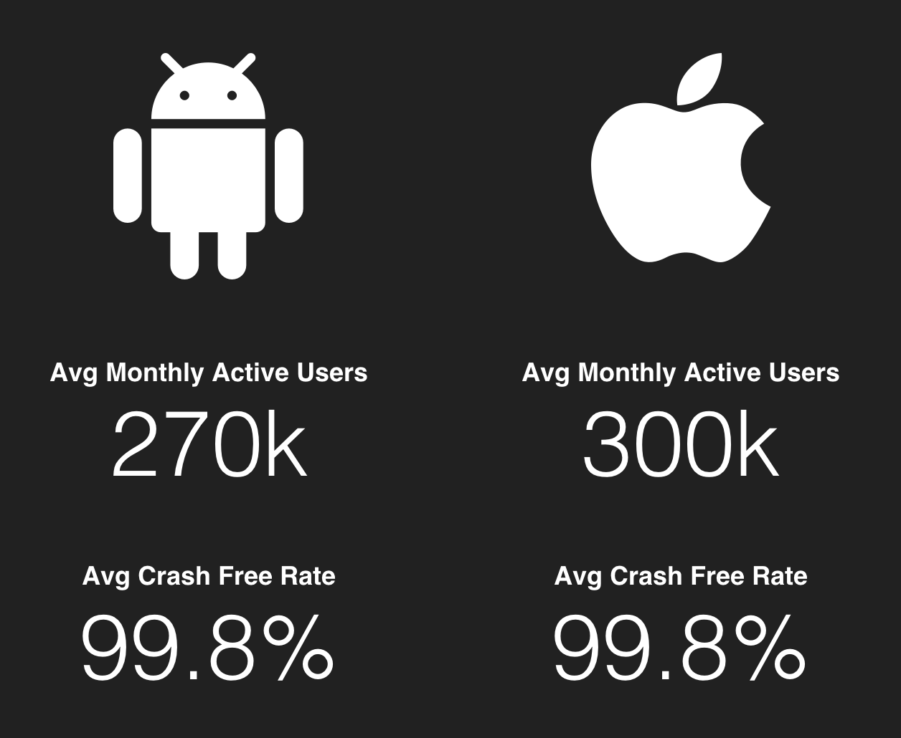

Slide 11

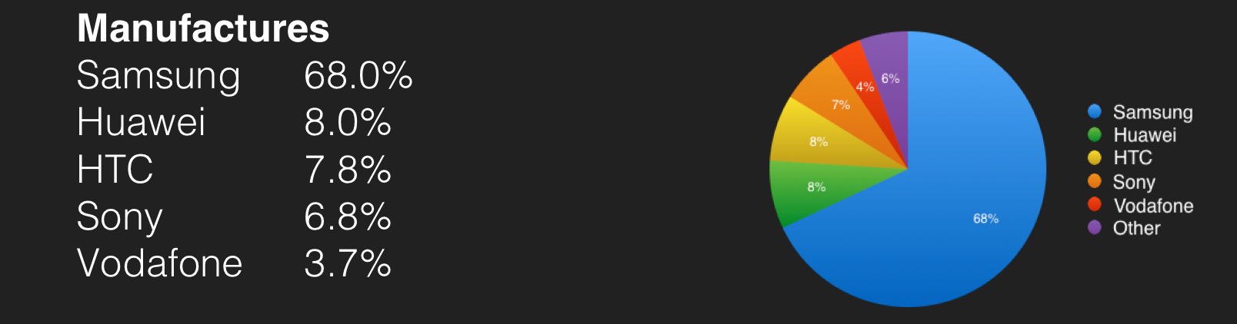
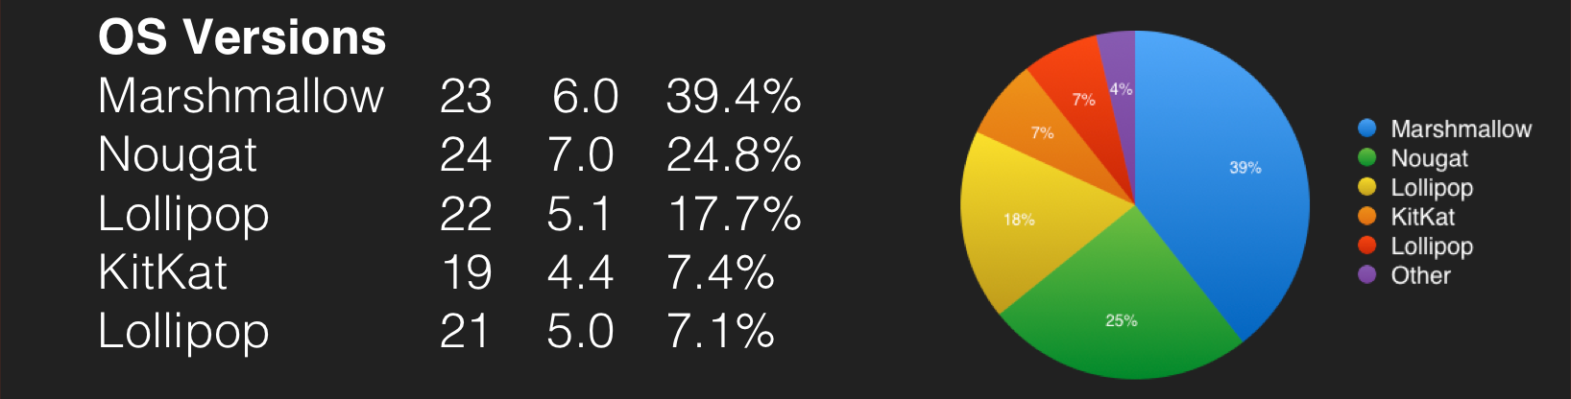

Slide 12

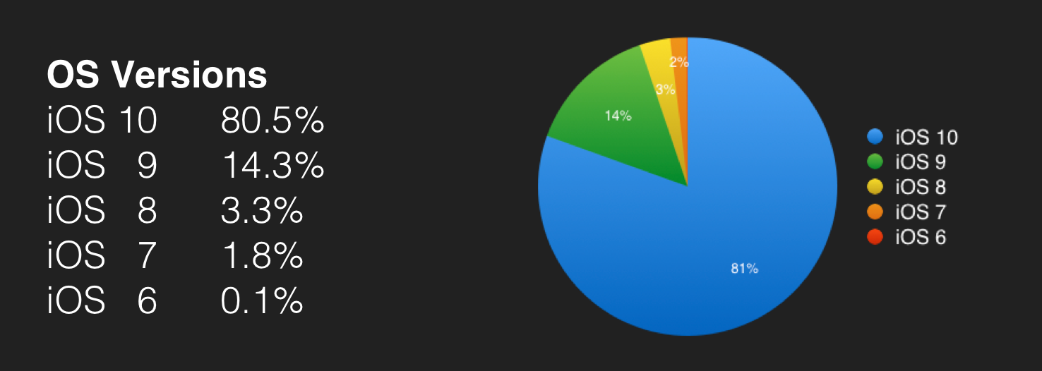
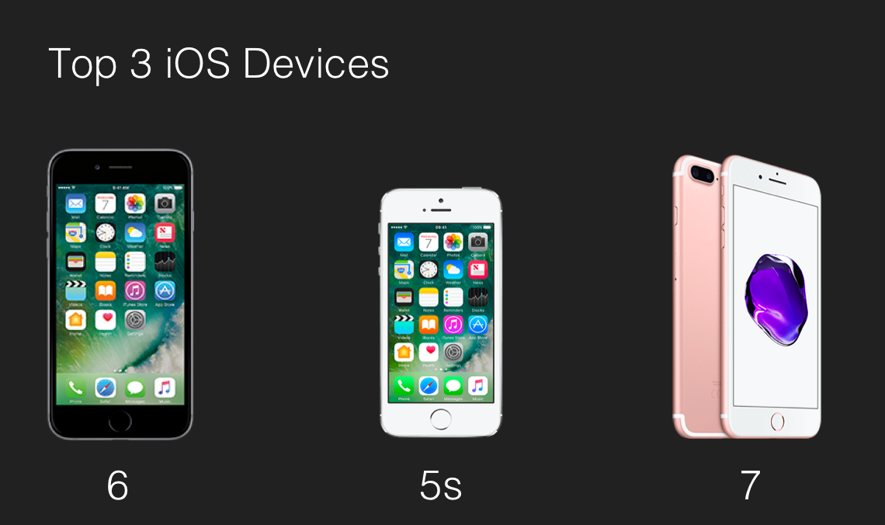

Slide 13

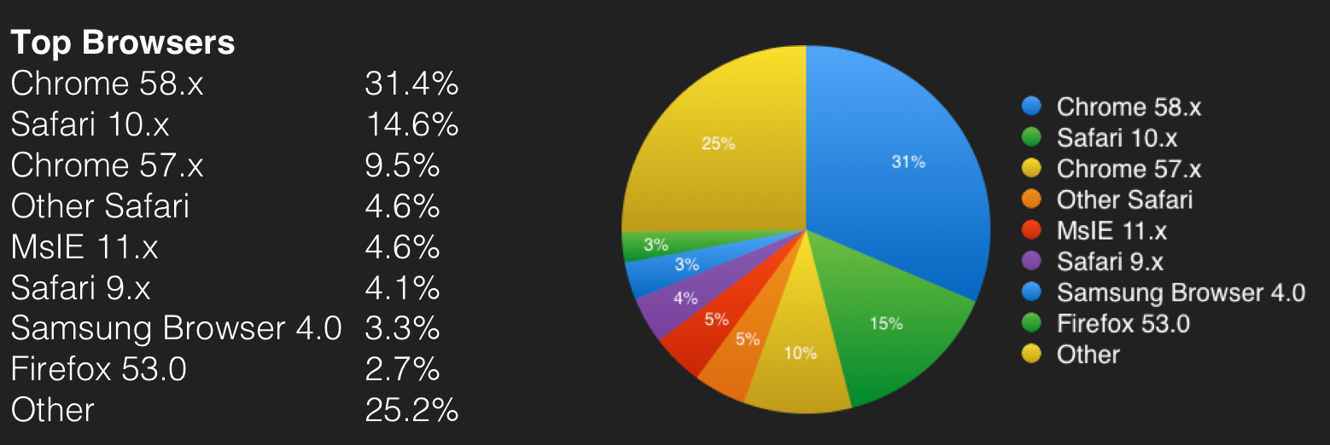
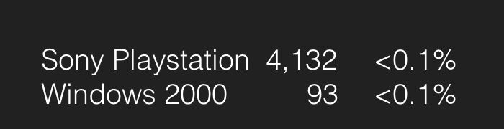
Notes:
Data is looking at visits in May ‘17

Slide 14
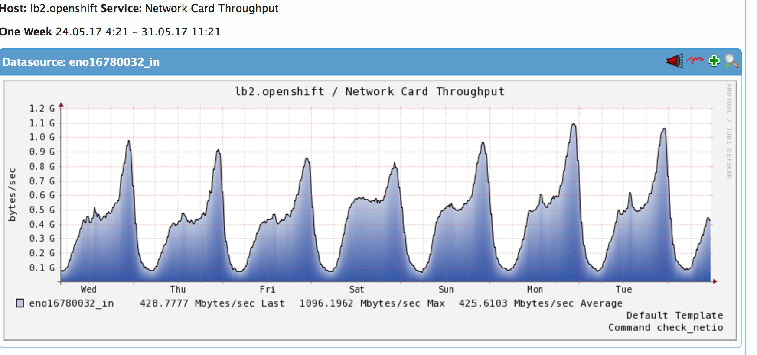
Internal Load Balancer Traffic
We have 2 internal HAProxy load balancers. This is the graph of data through a single lb for a week

Slide 15
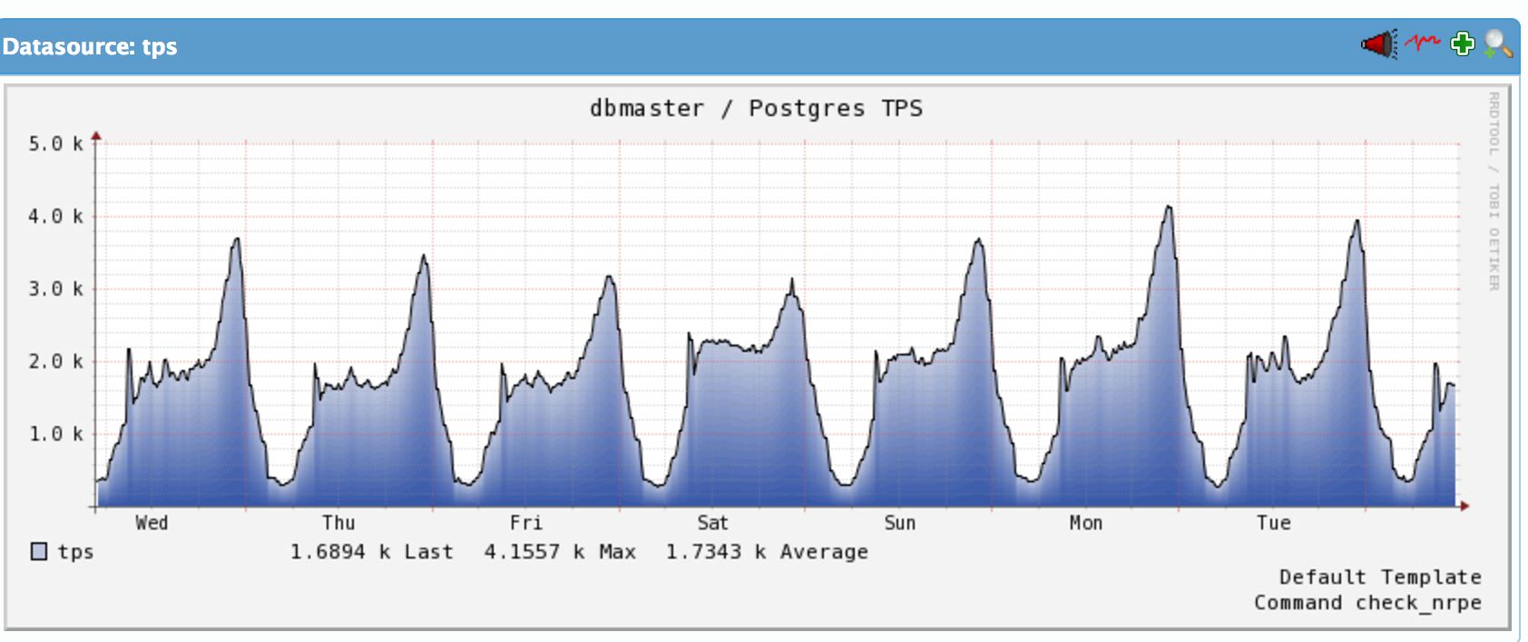
Database TX/s

Slide 16
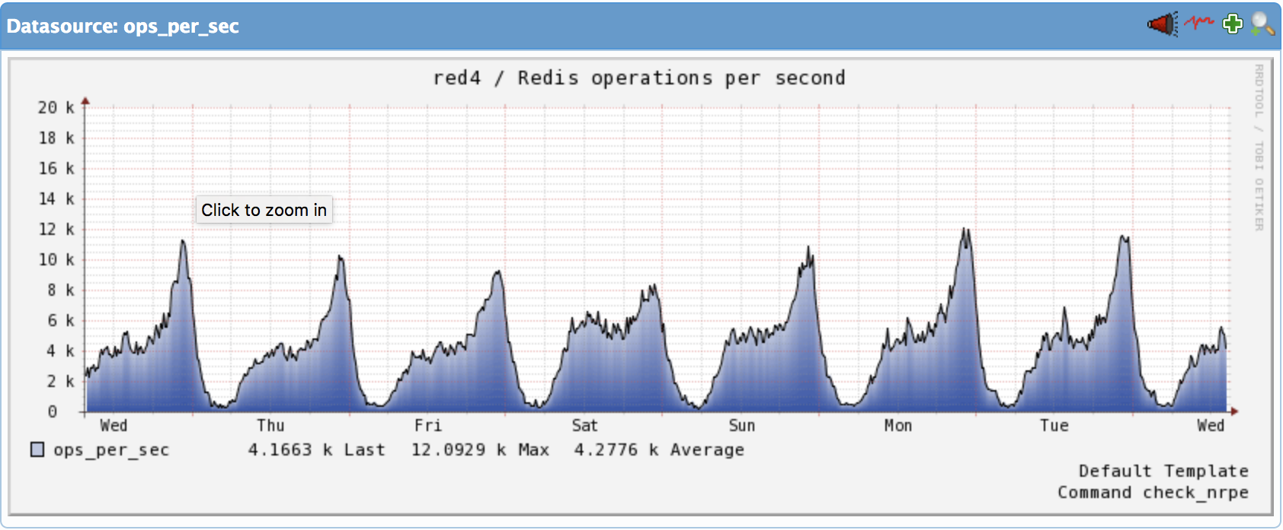
Redis Ops/s

Slide 17
Where next?
More Users +
More Content =
Bigger Challenges :D

Slide 18
Questions?
We are hiring!
#shamelessplug

